Slide 1
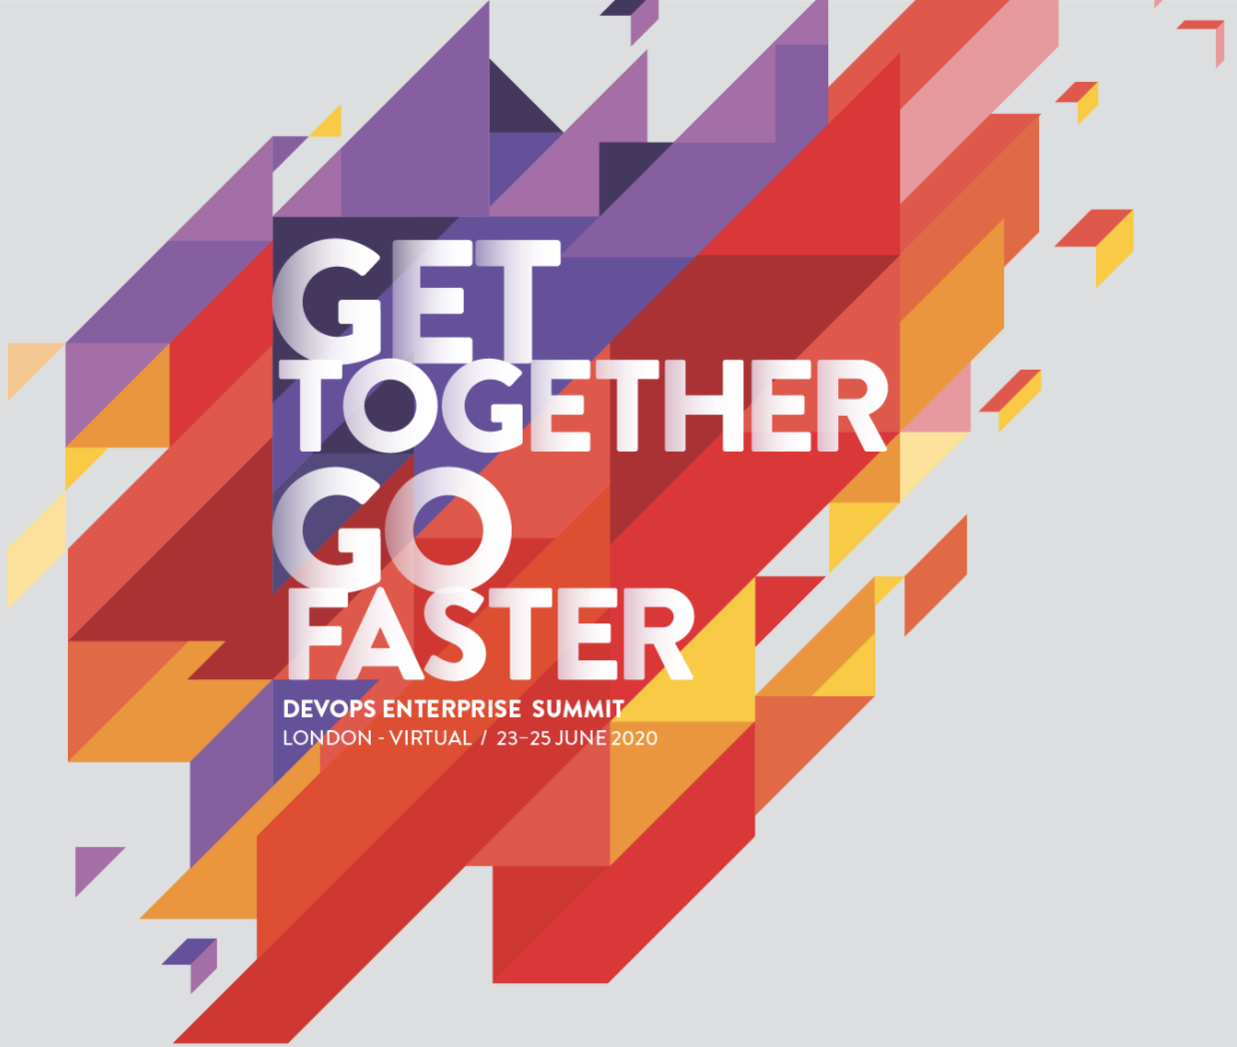
DevOps Enterprise Summit 2020
Key Takeaways
Austen Constable @austenconstable June 2020

Slide 2
"Culture eats strategy for breakfast"
- Peter Drucker

Slide 3
Jon Smart, Deloitte @jonsmart

Slide 4
Jon Smart, Deloitte @jonsmart

Slide 5
Jon Smart, Deloitte @jonsmart

Slide 6
Scott Prugh, CSG @ScottPrugh

Slide 7
Sam Guckenheimer , Microsoft @SamGuckenheimer

Slide 8
“You don’t want to be the bottleneck"
- Fernando Cornago, Adidas @fernicorni

Slide 9
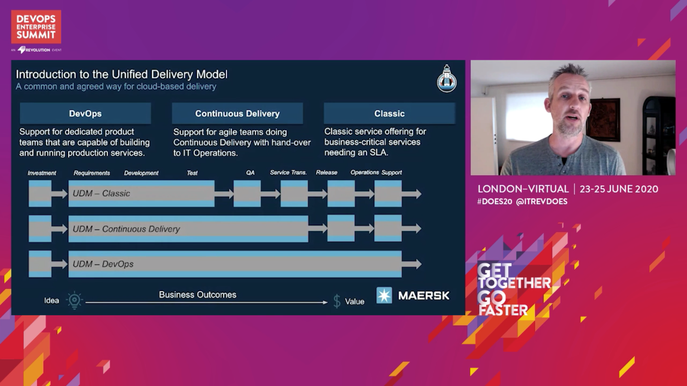
Rasmus Hald, Maersk @RusmusHaldDK

Slide 10
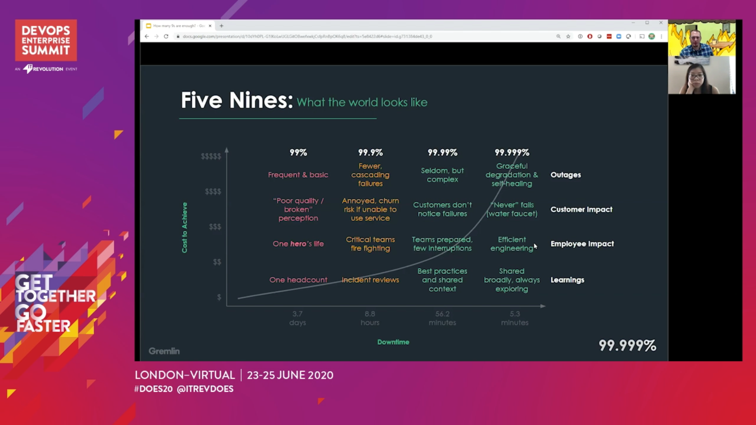
Kolton Andrus, Gremlin @KoltonAndrus

Slide 11
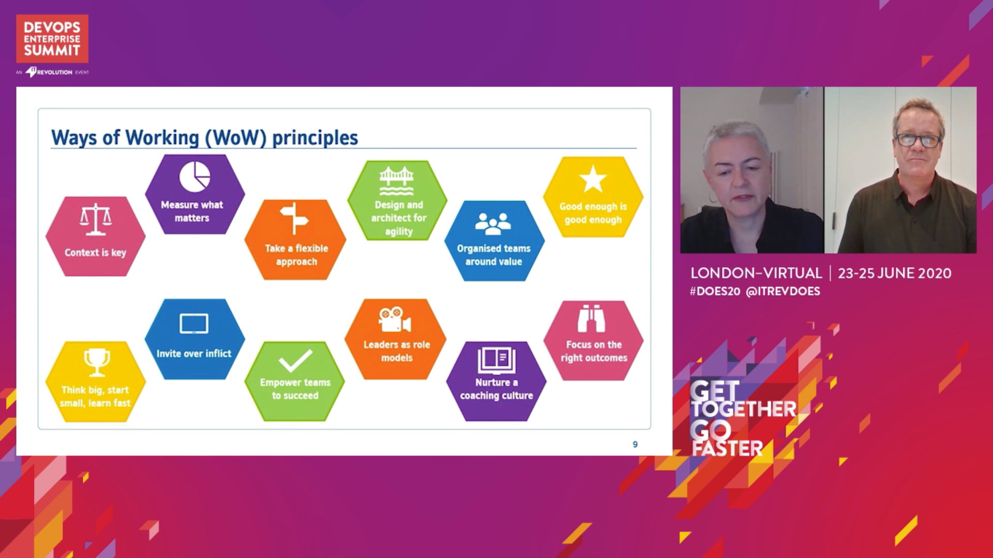
Janet Chapman & Patrick Eltridge, Nationwide Building Society

Slide 12
“Want to do an Agile Transformation? Don’t. Focus on Flow, Quality, Happiness, Safety and Value"
- Jon Smart, Deloitte @jonsmart

